Slide 1



Rodrigo Ribeiro Pierini
Data Science and Machine Learning
Project in NLP

Slide 2
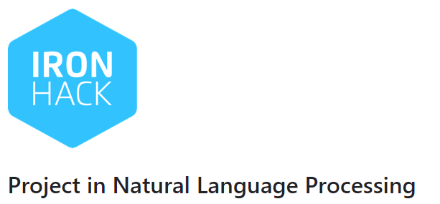
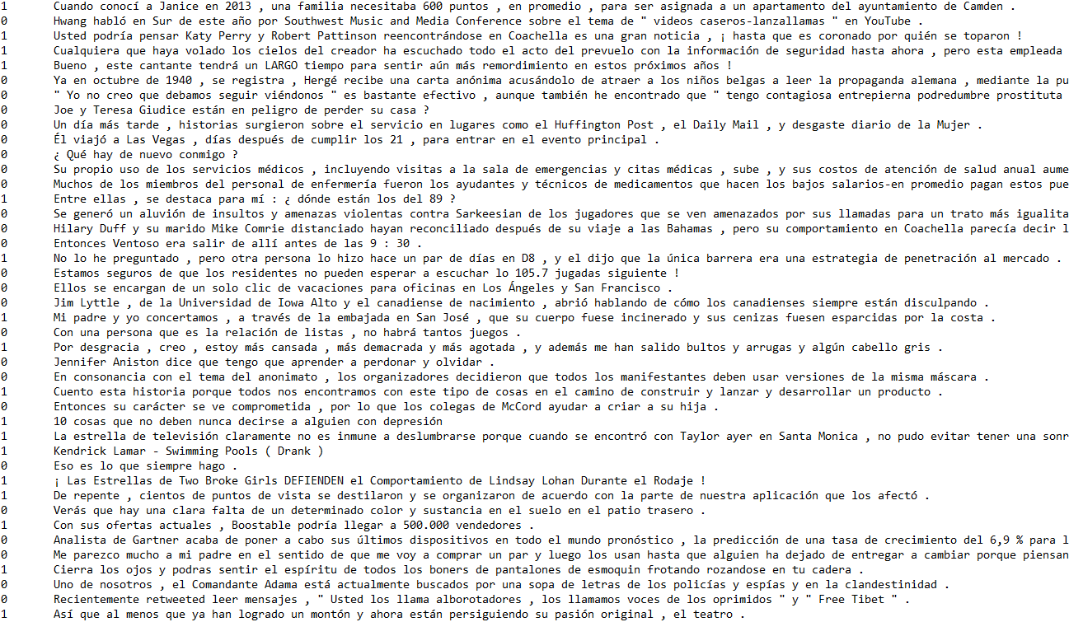
Tags
Spanish Texts:
Tags:
1 = Professional Translator
0 = Machine Translation

Slide 3
First approach:
- Data cleaning:
tokenizing
removing punctuation
lemmatization
removing Stopwords
lowercase
- Vectorize using TF-IDF

Slide 4

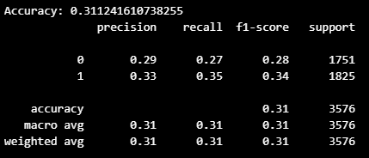
First approach:
Classifier = Random Forest

Slide 5
Second approach:
- Data cleaning:
tokenizing
removing punctuation
lemmatization
removing Stopwords
- Vectorize using TF-IDF

Slide 6
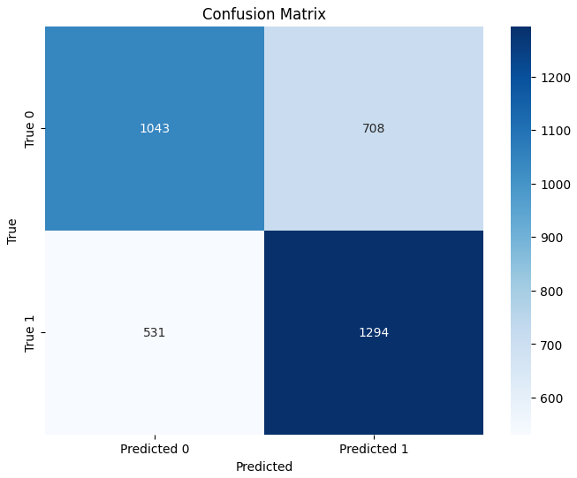
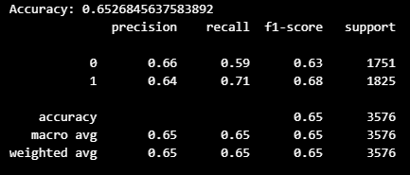
“Second” approach:
Classifier = Gradient Boosting
Tokenizer = Bert
Train/Test split = 80/20

Slide 7
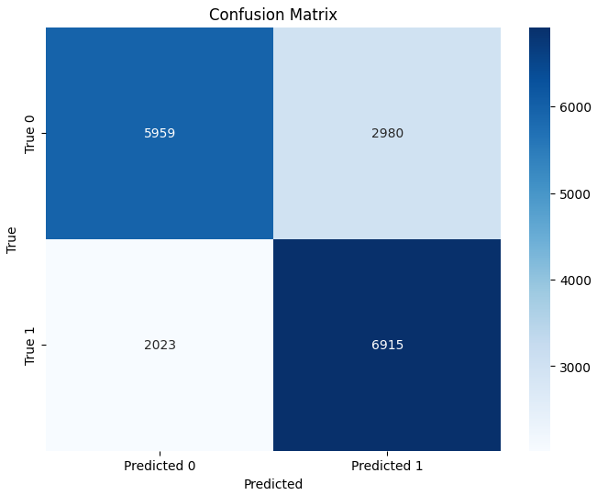
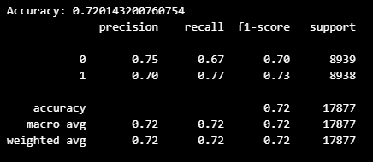
Fitting with 100% data
For the Real data

Slide 8
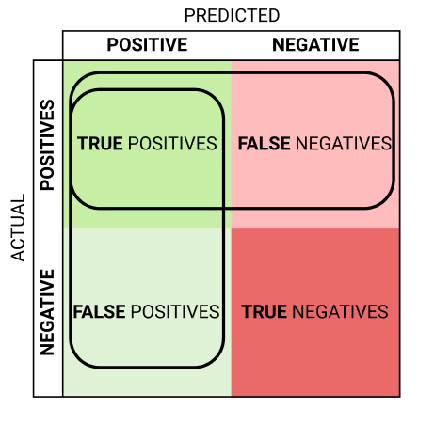
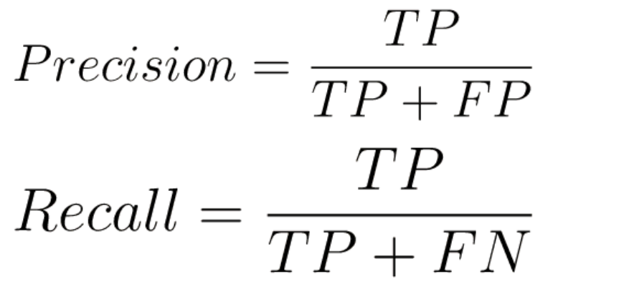
Improvements:
Measures:
FP
FN

Slide 9

Questions?

